Slide 1
Binding, Validation and Routing
Notes:
https://grpc.io/

Slide 2
Objectives
Model Binding
Model Binders: Primitive Model Binder, Complex Model Binder
Binding Types
Binding source parameter inference
Model Validation
Model validation in ASP.NET Core
Validation Built-in attributes
Server-Side Validation
Client-Side Validation
Routing
Enable Routing in ASP.NET Core Web API
Attribute Routing
Variables and Query Strings in Routing

Slide 3
Model Binding
Notes:
https://grpc.io/

Slide 4
What is Model binding
Model Binding is a process of ASP.NET Core framework to Extract Data from HTTP Requests and provide them to the arguments of Action Method.
The framework looks for action method’s argument value in the following 3 places:
1. Form data values
2. Routing variables
3. Query strings

Slide 5
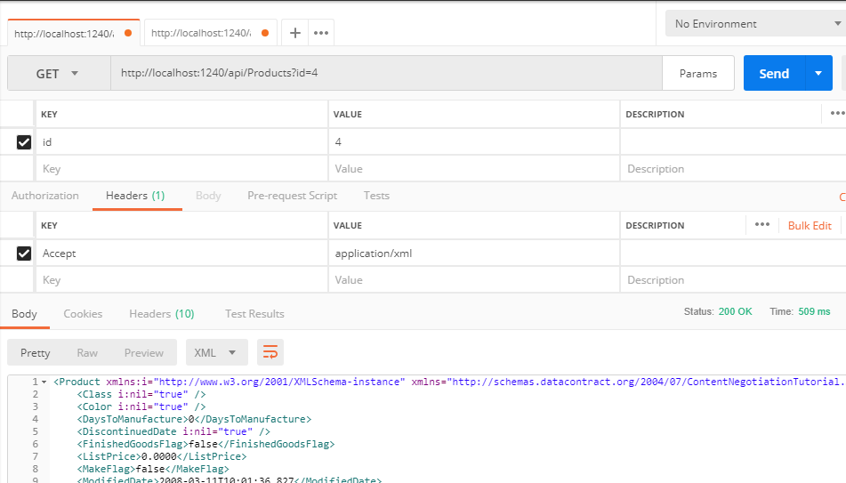
Model Binders - 1
Primitive Model Binder
If the request is simple, i.e. input parameter are of type int, string, Boolean, GUID, decimal, etc. and is available in the URL, then such kind of request is mapped to primitive model binding.
Data is available as Query String

Slide 6
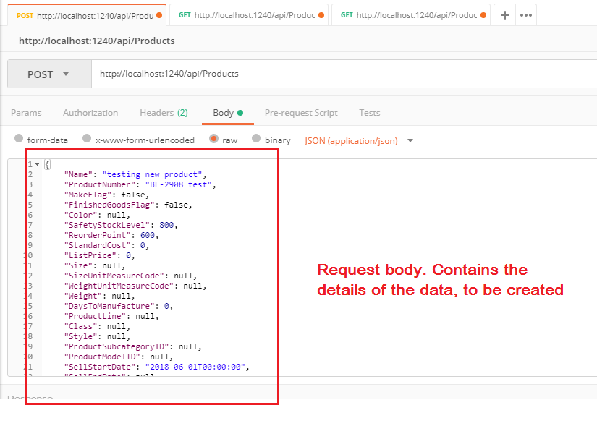
Model Binders - 2
Complex Model Binder
If the request is complex, i.e. we pass data in request body as an entity with the desired content-type, then such kind of request is mapped by Complex model binder.
Data not available via Query String

Slide 7
Binding Types
Primitive Type Binding
HTTP Methods like GET and DELETE where you are only required to send less quantity of input parameters, uses primitive type binding, by default.
Complex Type Binding
HTTP Methods like POST and PUT where you have to send the send model/entity data to the server, uses complex type binding, by default.
POST and PUT can also use combination of primitive and complex type. Consider you want to update data. So you can pass the Id in query string and the data to be updated in response body.

Slide 8
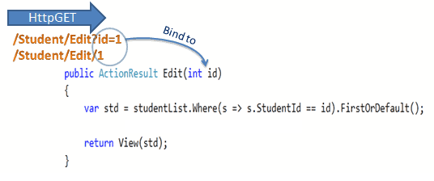
Model Binding for Primitive Types
If the parameter is a "simple" type, ASP.NET Core Web API tries to get the value from the URI.
Simple types include the .NET primitive types (int, bool, double, and so forth), plus TimeSpan, DateTime, Guid, decimal, and string, plus any type with a type converter that can convert from a string.
Notes:
https://docs.microsoft.com/en-us/dotnet/api/system.type.isprimitive?view=net-5.0

Slide 9
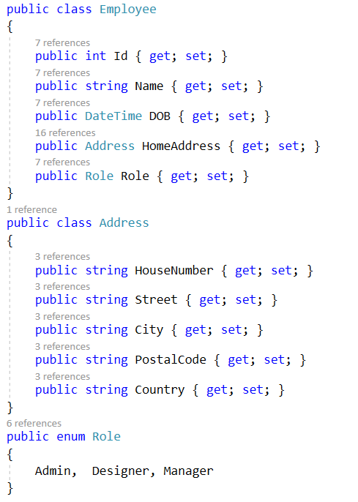
Model Binding for Complex Types - Example
When the argument of the action method is a complex type like a class object then Model Binding process gets all the public properties of the complex type and performs the binding for each of them.

Slide 10
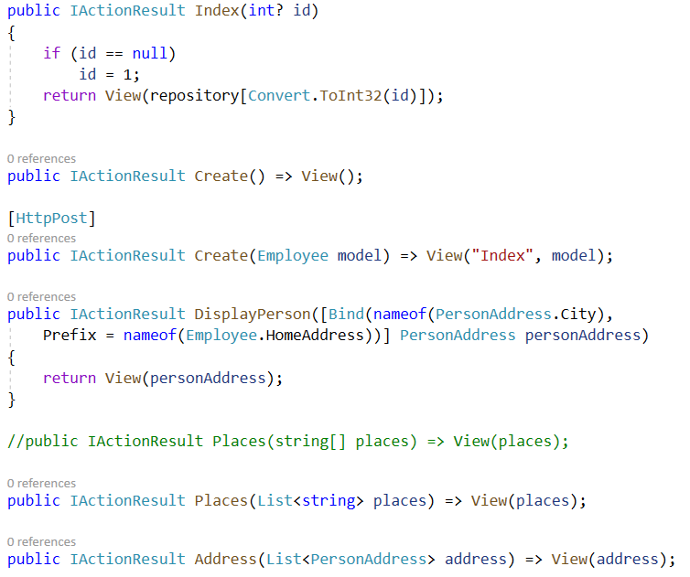
Model Binding for Complex Types - Example

Slide 11
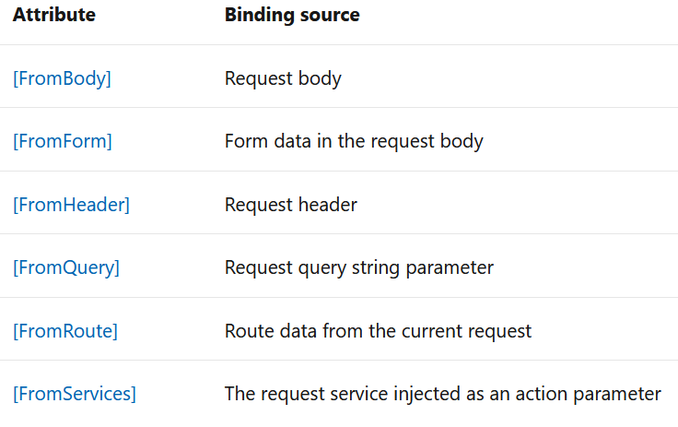
Binding source parameter inference
A binding source attribute defines the location at which an action parameter's value is found.

Slide 12
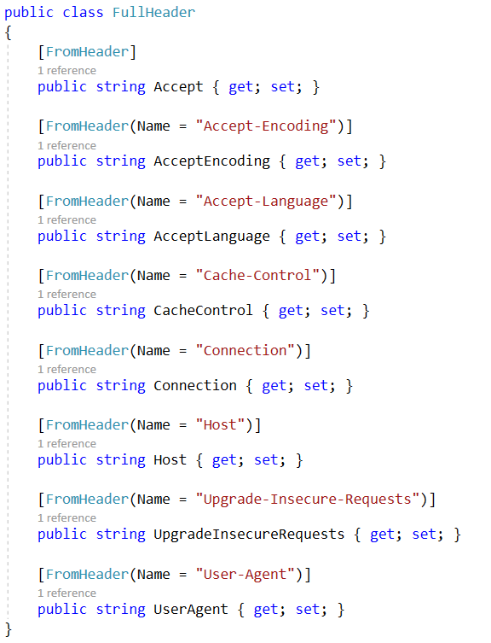

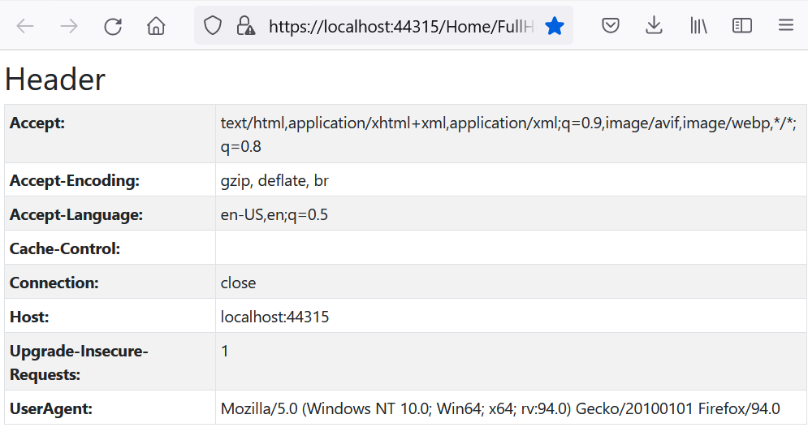
Attribute [FromHeader]

Slide 13
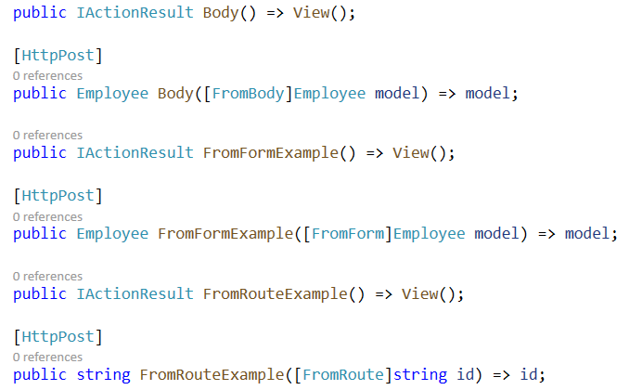
Attribute [FromRoute], [FromForm], [FromBody]

Slide 14
Model Binding in ASP.NET Core
If ASP.NET Core framework does not find the values of the action method’s argument in any of the three locations – Form data values, Routing variables & Query strings. In that case it will provide the default values based on the type of the action method’s argument. Default Binding Values:
0 for int
“” for string
01-01-0001 00:00:00 for DateTime
0 for float

Slide 15
More about Model Binding
Model Binding to Arrays - Can do Model Binding for array type parameter
Model Binding to Collection - Model binding also supports Collection.
Model Binding for Collections of Complex Types

Slide 16
Model Validation
Notes:
https://grpc.io/

Slide 17
Model validation in ASP.NET Core
When a user submits form field values, proper validation can help build a more user-friendly and secure web application. Instead of coding each view/page individually, you can simply use server-side attributes in your models/viewmodels.
Model validation in ASP.NET Core
Model state
Rerun validation
Validation attributes
Built-in attributes

Slide 18
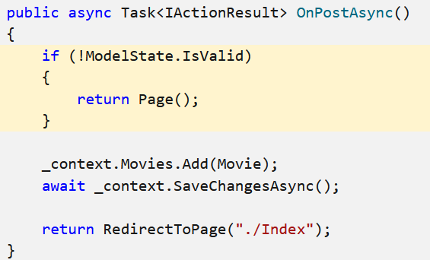
Model state
Model state represents errors that come from two subsystems: model binding and model validation. Errors that originate from model binding are generally data conversion errors.
Both model binding and model validation occur before the execution of a controller action or a Razor Pages handler method.

Slide 19
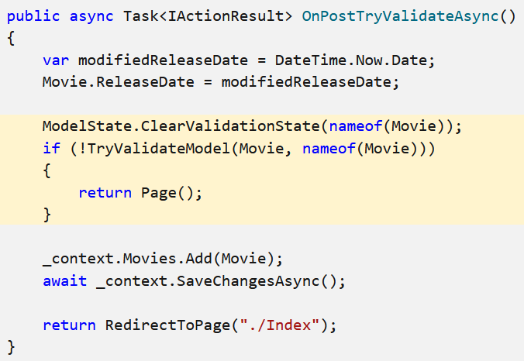
Rerun validation
Validation is automatic, but you might want to repeat it manually.
You might compute a value for a property and want to rerun validation after setting the property to the computed value.
To rerun validation, call ModelStateDictionary.ClearValidationState to clear validation specific to the model being validated followed by TryValidateModel.

Slide 20
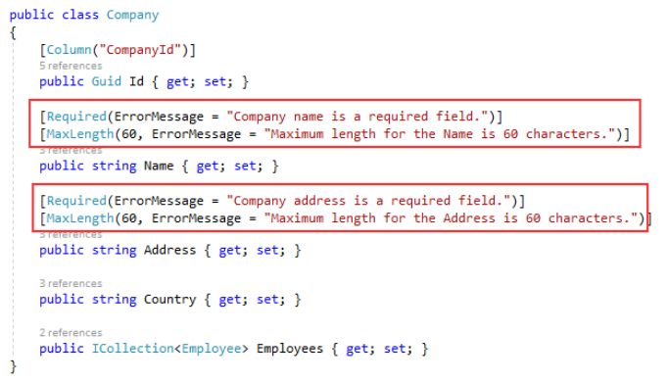
Validation attributes
Validation attributes let you specify validation rules for model properties.
Use attributes from the System.ComponentModel.DataAnnotations namespace to set validation rules for properties on your model.

Slide 21
Validation Built-in attributes
[ValidateNever]: Excluded from validation.
[CreditCard]: Validates that the property has a credit card format. Requires jQuery Validation Additional Methods.
[Compare]: Validates that two properties in a model match.
[EmailAddress]: Validates that the property has an email format.
[Phone]: Validates that the property has a telephone number format.
[Range]: Validates that the property value falls within a specified range.
[RegularExpression]: Validates that the property value matches a specified regular expression.
[Required]: Validates that the field is not null.
[StringLength]: Validates that a string value doesn't exceed a specified length.
[Url]: Validates that the property has a URL format.

Slide 22
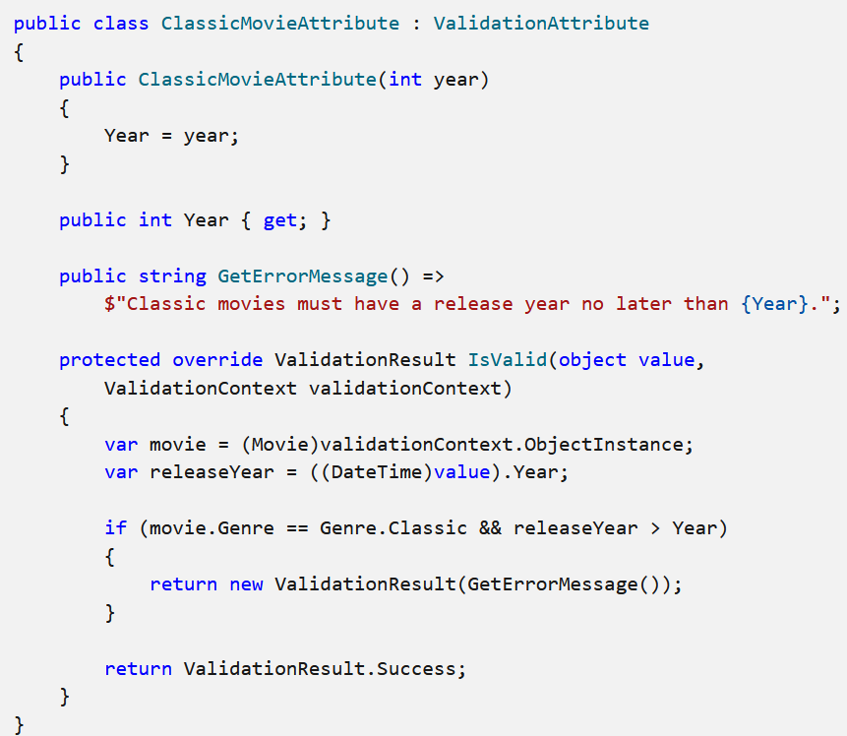
Validation Custom attributes
Create a class that inherits from ValidationAttribute, and override the IsValid method.
The IsValid method accepts an object named value, which is the input to be validated. An overload also accepts a ValidationContext object, which provides additional information, such as the model instance created by model binding.

Slide 23
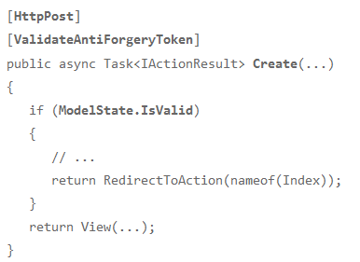
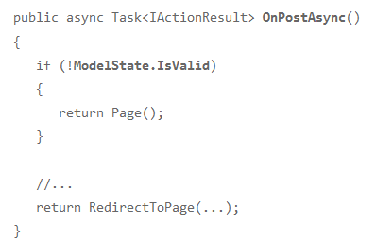
Server-Side Validation
Validation occurs before an MVC controller action (or equivalent handler method for Razor Pages) takes over.
As a result, you should check to see if the validation has passed before continuing next steps.

Slide 24
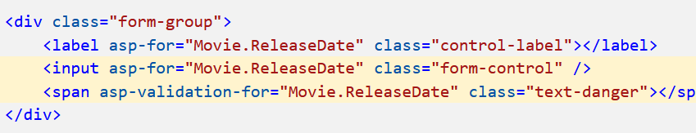
Client-Side Validation
Client-side validation prevents submission until the form is valid. The Submit button runs JavaScript that either submits the form or displays error messages.
Client-side validation avoids an unnecessary round trip to the server when there are input errors on a form.
<script src="https://cdnjs.cloudflare.com/ajax/libs/jquery/3.4.1/jquery.min.js"></script>
<script src="https://cdnjs.cloudflare.com/ajax/libs/jquery-validate/1.19.1/jquery.validate.min.js"></script>
<script src="https://cdnjs.cloudflare.com/ajax/libs/jquery-validation-unobtrusive/3.2.11/jquery.validate.unobtrusive.min.js"></script>

Slide 25
Routing in ASP.NET Core Web API
Notes:
https://grpc.io/

Slide 26
Enable Routing in ASP.NET Core Web API
In ASP.NET Core Web API Application, we can enable the Routing through Middleware. In order to enable Routing in ASP.NET Core, we need to add the following two middleware components to the HTTP Request processing Pipeline.
UseRouting(): The UseRouting Middleware only enables the Routing for your application. This will not map any URL to any resource.
UseEndpoints(): This middleware will map the URL to the resource. But the most important point that you need to remember is, the action methods are not only the resource that you can map. You can also map static file resources to a URL. But here we are only focusing on ASP.NET Core Web API and hence we are going to map the URL to action methods.

Slide 27
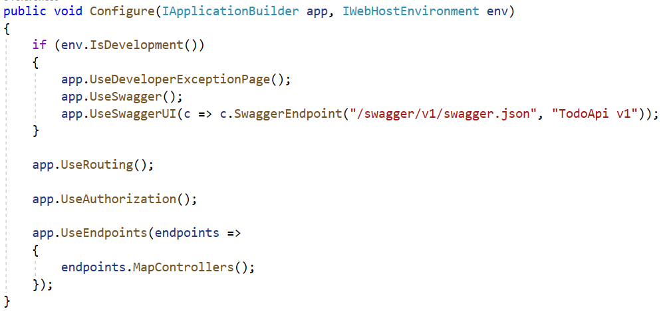
Configuring the Routing Middlewares
Modify the Configure method of the Startup class as shown below to configure the UseRouting and UseEndpoints Middlewares which will enable Routing as well as the mapping between the URL and Resource.

Slide 28
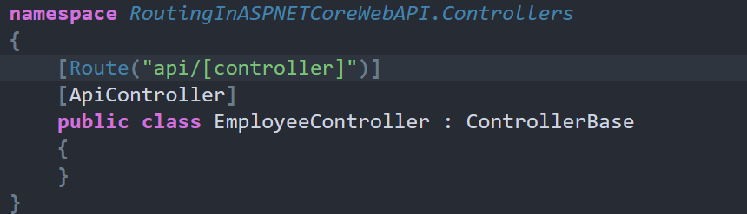
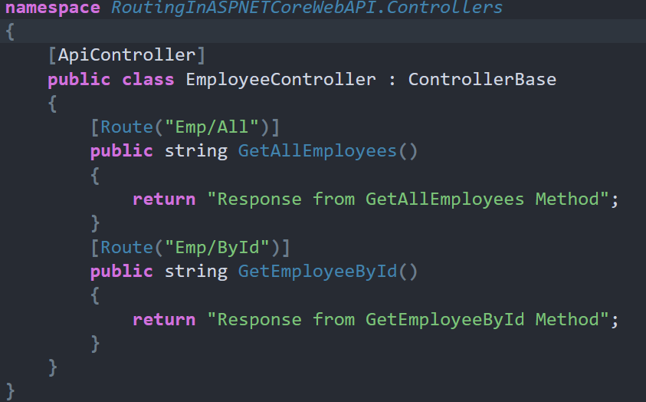
Attribute Routing
Attribute Routing is the most preferred way of defining routes in ASP.NET Core Web API Application

Slide 29
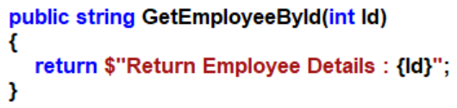
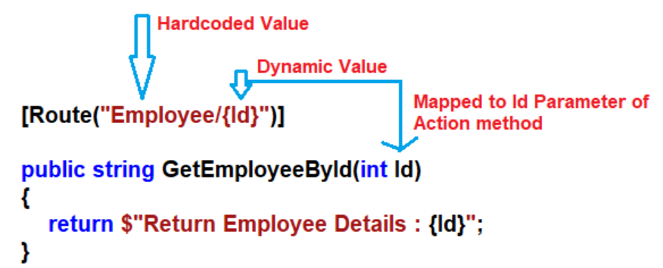
Variables and Query Strings in Routing
In ASP.NET Core Web Application, if you want to pass anything as a variable then you need to use curly braces {} and inside the curly braces, you need to give the name of the parameter your method accepting.

Slide 30
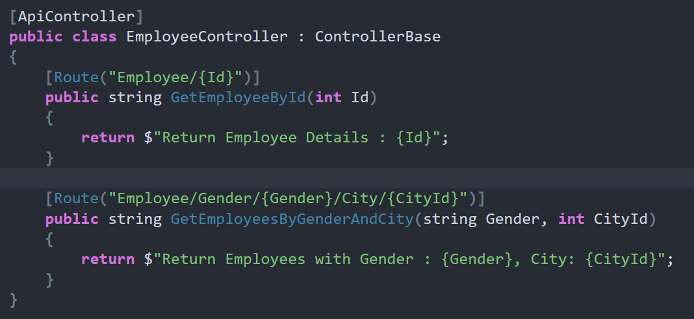
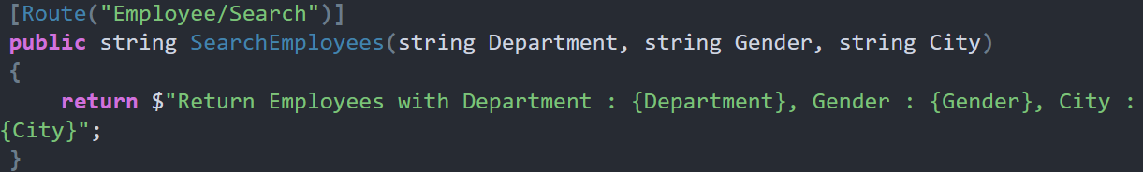
Passing Multiple dynamic Values
Passing Multiple dynamic Values in ASP.NET Core Web API Routing

Slide 31
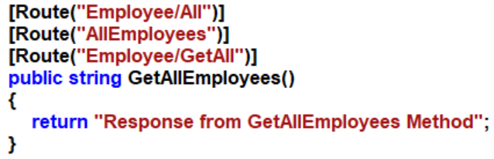
Multiple URLs for a Single Resource using Routing
Can access the resource with different URLs in the ASP.NET Core Web API Application.

Slide 32
Demo: ASP.NET Core Web API with Validation and Routing
Notes:
https://grpc.io/

Slide 33
Using Database Model and Repository pattern
With the Repository pattern, we create an abstraction layer between the data access and the business logic layer of an application.
By using Repository pattern, we are promoting a more loosely coupled approach to access our data in the database.
The code becomes cleaner, easier to maintain, and reusable. Data access logic is stored in a separate class, or sets of classes called a repository, with the responsibility of persisting the application’s business model.

Slide 34
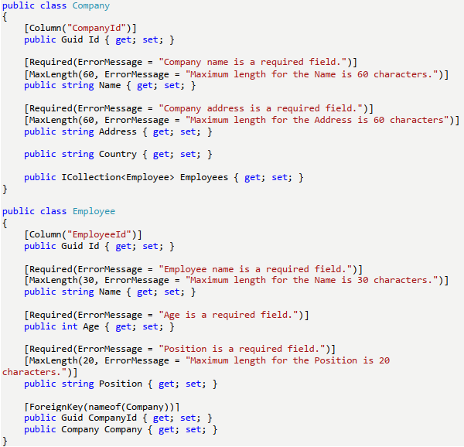
Example with Repository Pattern - 1
Model classes

Slide 35
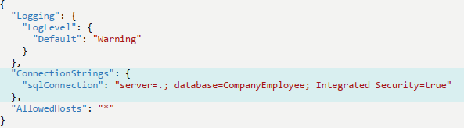
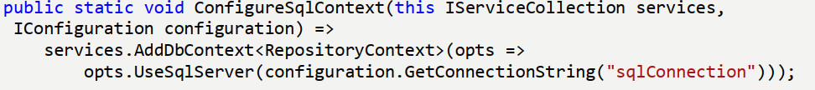
Example with Repository Pattern - 2
Database connection (appsettings.json)
Add the method for ServiceExtensions class.

Slide 36
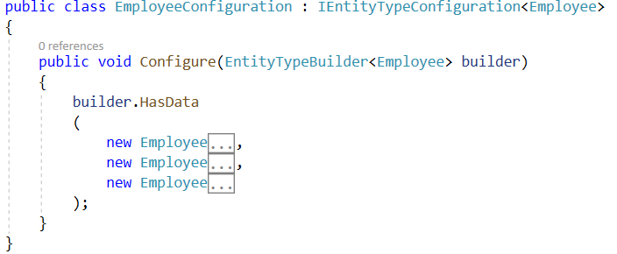
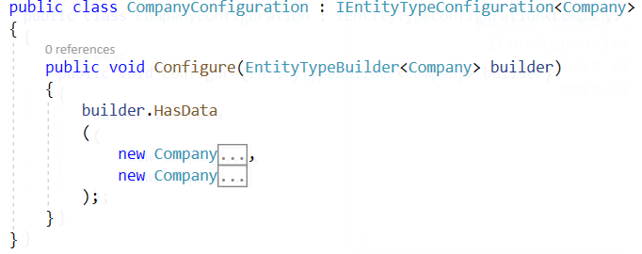
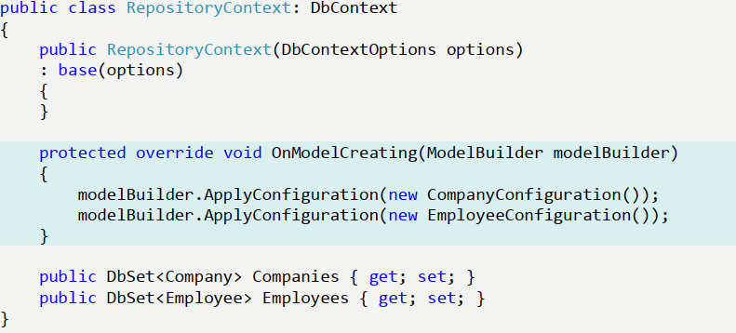
Example with Repository Pattern - 3
Add the data in the model creation: CompanyConfiguration, EmployeeConfiguration
Context class

Slide 37
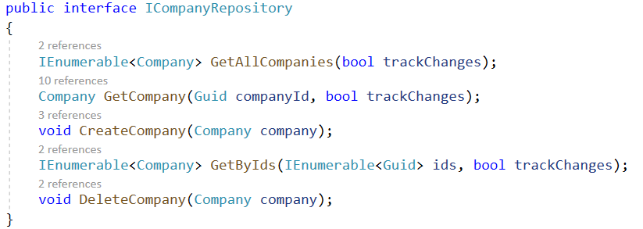
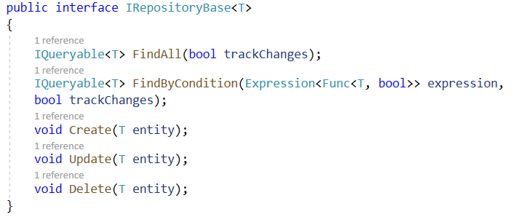
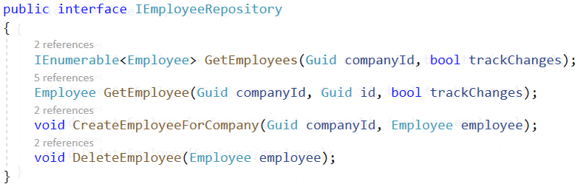
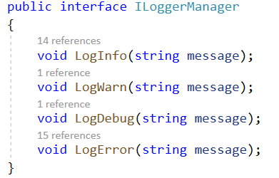
Example with Repository Pattern - 3
Repository Pattern Logic

Slide 38
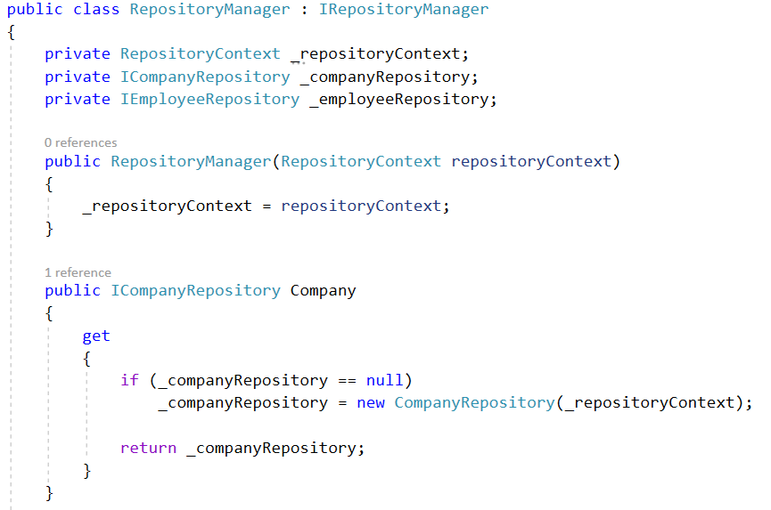
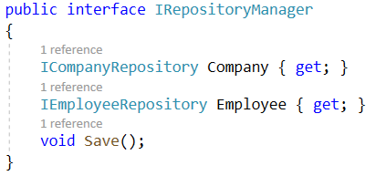
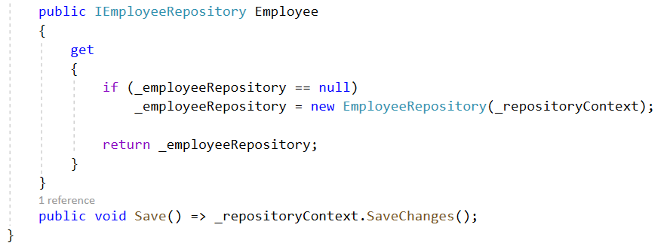
Repository Manager

Slide 39
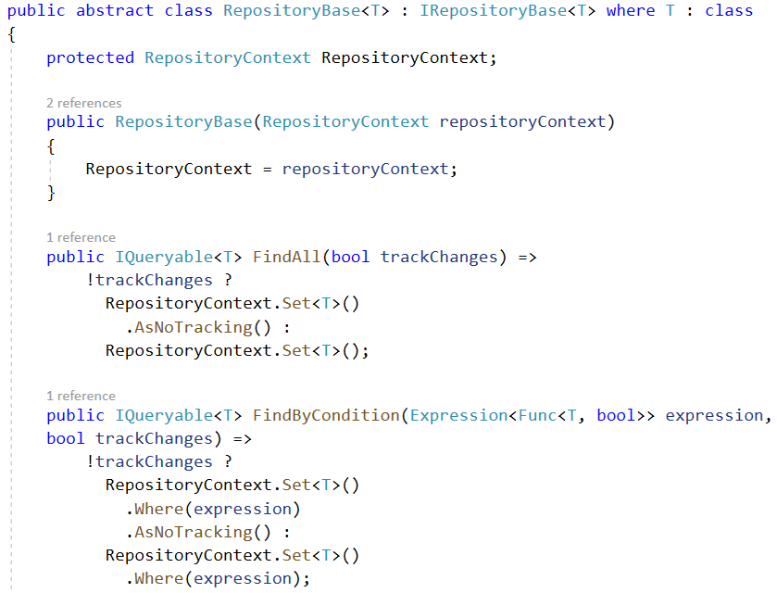
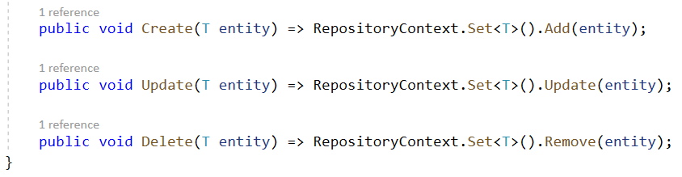
Classes implement interfaces - 1

Slide 40
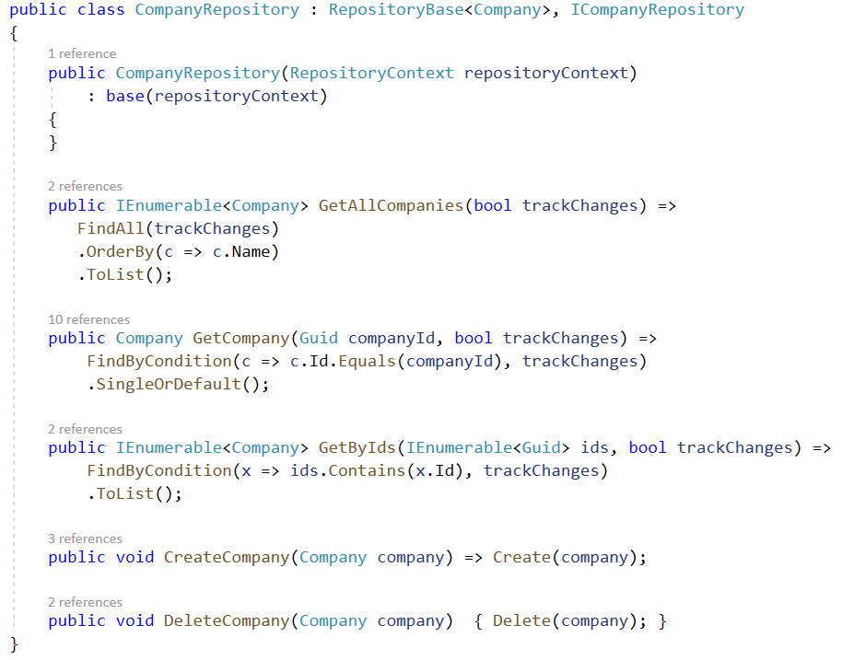
Classes implement interfaces - 2

Slide 41
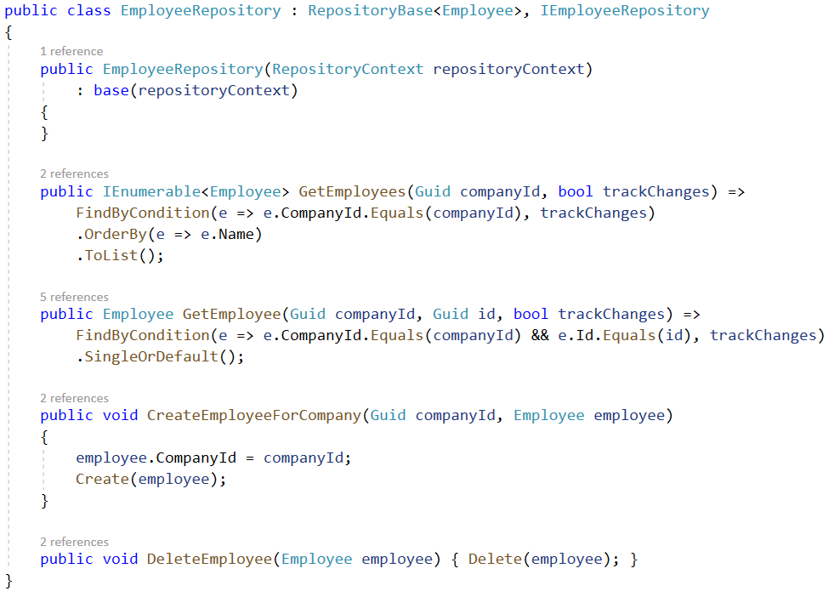
Classes implement interfaces - 3

Slide 42
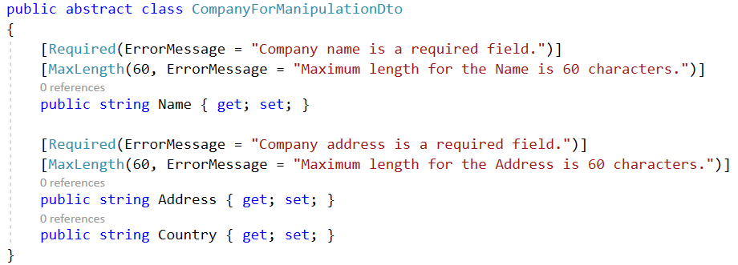
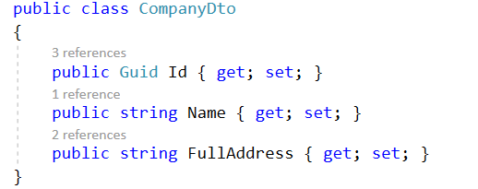
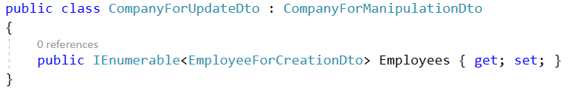
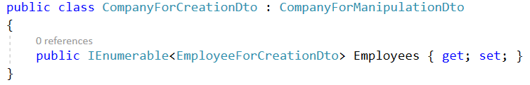
Data Transfer Objects (DTOs) - 1

Slide 43
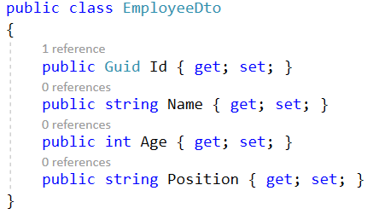
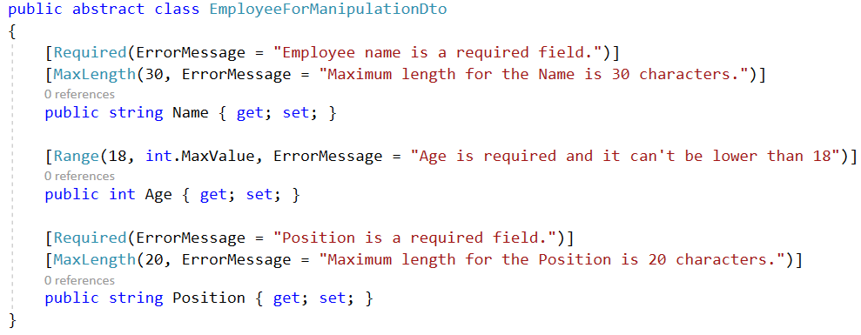


Data Transfer Objects (DTOs) - 2

Slide 44
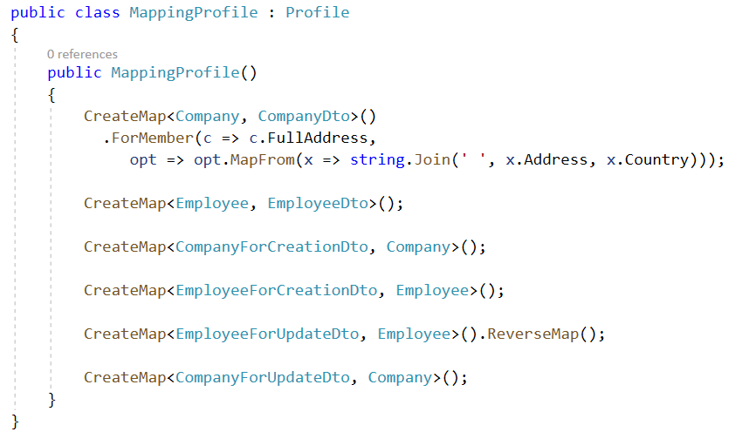
Using AutoMapper

Slide 45
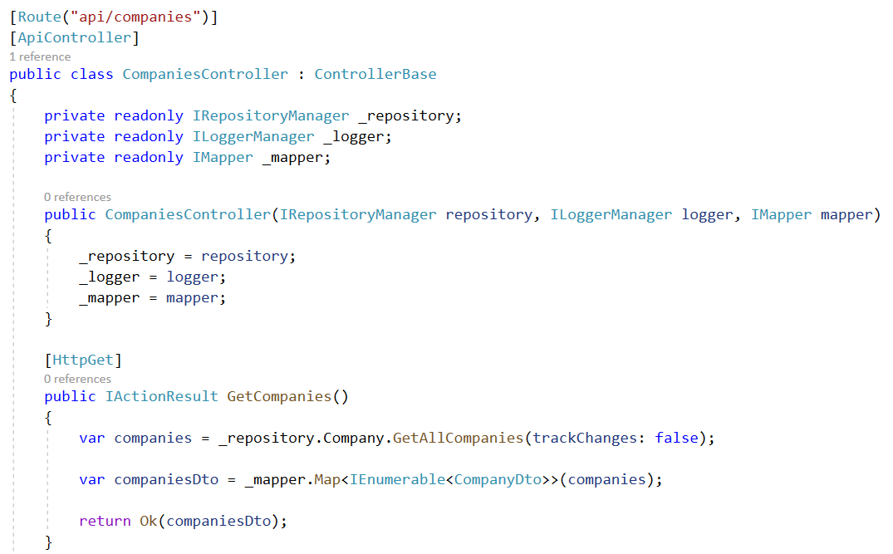
API Controllers - Company Controller 1

Slide 46
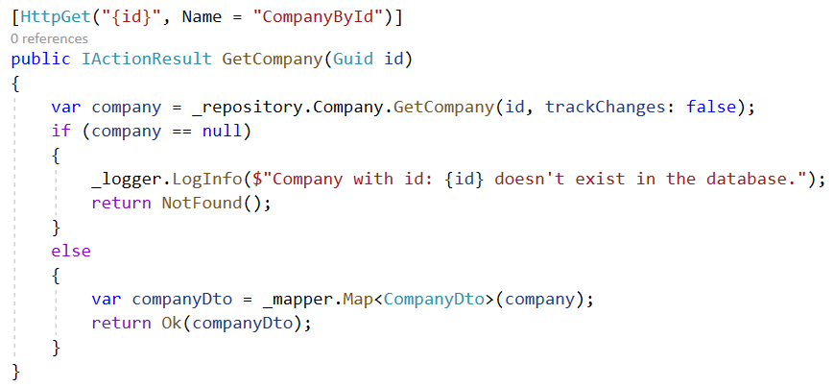

API Controllers - Company Controller 2

Slide 47


API Controllers - Company Controller 3

Slide 48

API Controllers - Employee Controller - 1

Slide 49

API Controllers - Employee Controller - 2

Slide 50

API Controllers - Employee Controller - 3

Slide 51

API Controllers - Employee Controller - 4

Slide 52

API Controllers - Employee Controller - 5

Slide 53


Using Postman to test the Web API

Slide 54
Summary
Concepts were introduced
Model Binding
Model Binders: Primitive Model Binder, Complex Model Binder
Binding Types, Binding source parameter inference
Model Validation
Model validation in ASP.NET Core
Validation Built-in attributes
Server-Side Validation, Client-Side Validation
Routing
Enable Routing in ASP.NET Core Web API
Attribute Routing
Variables and Query Strings in Routing

